Slide 1

PTM Project
*Niv Vaknin
* Eynav Ptia
*Samuel Krief
* Koral Duel

Slide 2
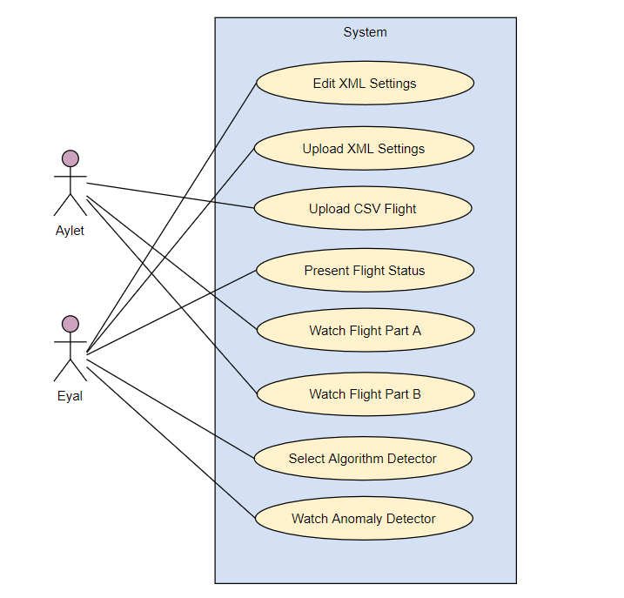
Requirements :

Slide 3
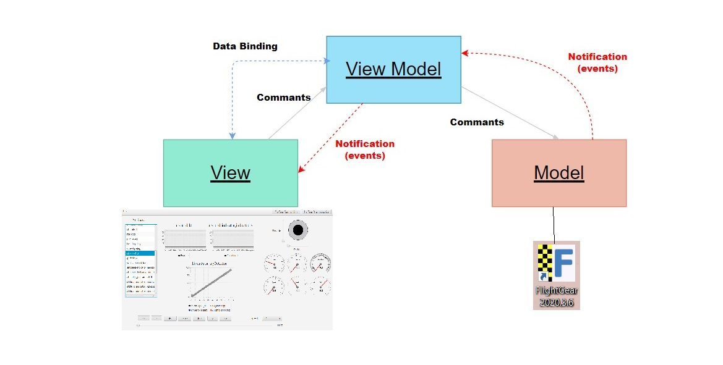
Mvvm Architecture

Slide 4
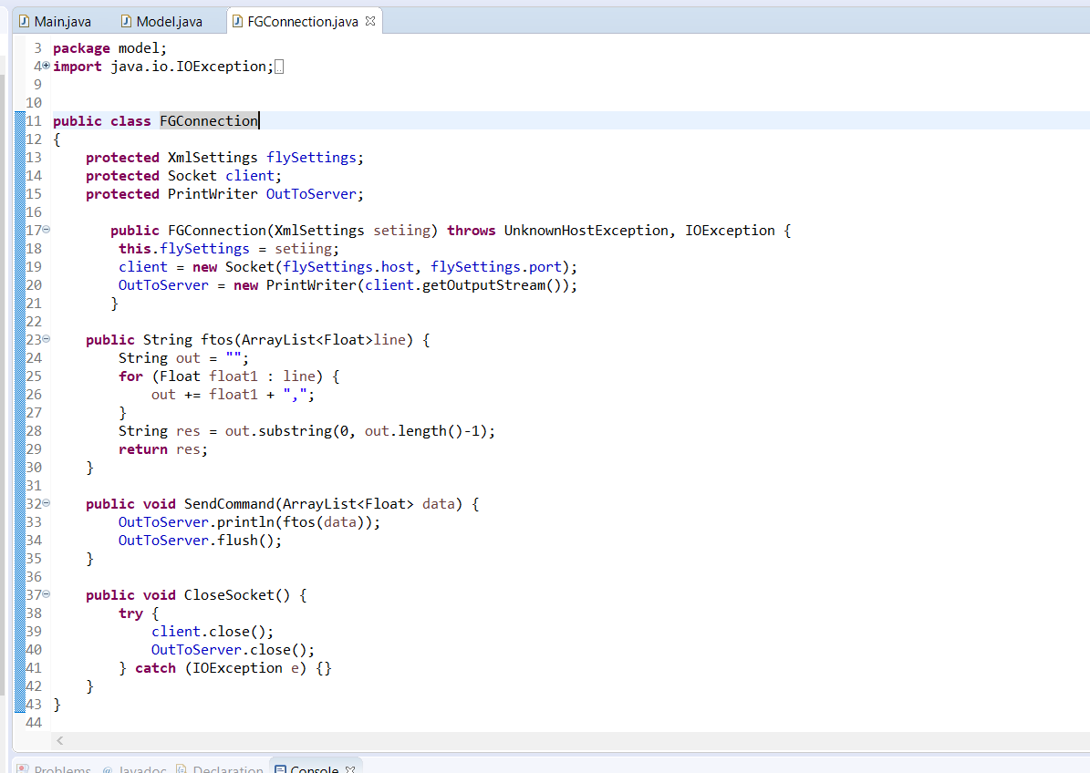
Interesting Code Examples:
In this class the link to the Flight Gear is made

Slide 5
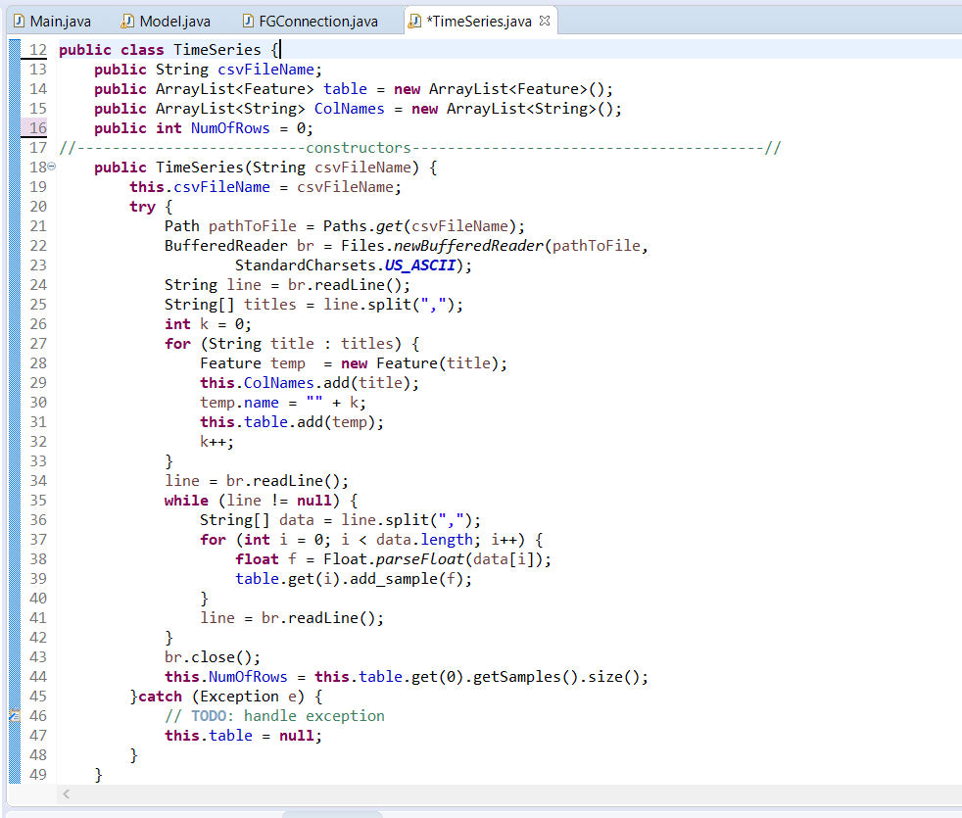
This class is responsible for loading data from csv file and saving it as object

